Slide 1

News Feed Application Presentation Date – 20/4/2023 Noam Ifargan Accompanying Lecturer – Dr. Aiad Soliman

Slide 2
View The Problem
the challenge of keeping up with the latest news from multiple sources. With so many news sources available on the internet, users can find it challenging to stay informed about the news, especially if they have to visit multiple websites to access different perspectives on a topic.
visiting multiple news websites can be time-consuming, inconvenient, and can lead to information overload. Users may also face the challenge of identifying and avoiding biased news sources or irrelevant news articles that are not relevant to their interests.

Slide 3
The solution to the presented problem
To solve this problem, a news feed application that collects data from multiple news websites was developed. This application aggregates news articles from various sources and provides users with a single platform to access the latest news in a convenient, efficient, and personalized way.
By doing so, it saves users time and effort, provides them with a more comprehensive view of the news, and eliminates the need to visit multiple websites.

Slide 4
Appearance of a landing page with the logo of the site for a few seconds and then go to the main page
The user chooses from which site he wants to view the articles and by clicking on the relevant button he is transferred to the list of articles of that site
A list of the most recent articles for that desired site appears on the screen, with scrolling option
Each article has a relevant image, a description of the article, a date of publication, and a title.
By clicking on a specific article in the list, the user is taken to the original site with the full article
In the return button, the user can return to the article list page
By clicking on the Like button, the user can rate an article as correct and thus increase the number of its likes.
Product Description

Slide 5
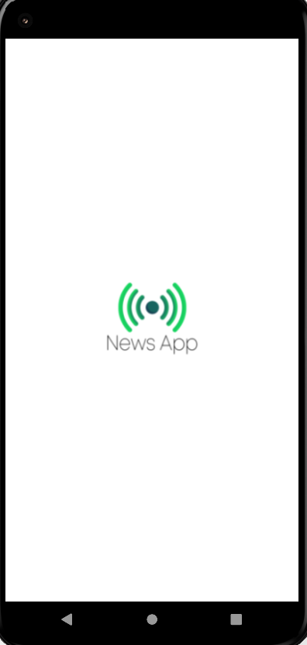
Landing Page
At the initial launch of the app, the app’s logo first appears for a few seconds and only then the app itself.
This was done in order to create a landing page for the application and allow the application to load optimally.

Slide 6
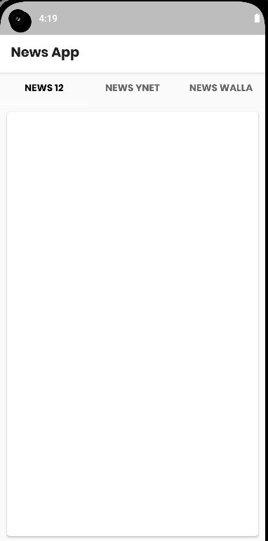
The Main Page
In the Top of the main page, there is a Tab layout that contains three tabs.
Each tab is actually a button, where by clicking on it the user choose from which source of information(news site) to view the articles.
By pressing on certain button, all articles from that desired site will be displayed on the screen.

Slide 7
Using RSS
It's a type of web feed that allows users to access updates to online content, such as articles or blog posts, in a standardized format.
RSS feeds are usually displayed in a news aggregator or reader, which can be a standalone application or a built-in feature of a web browser or email client.
RSS feeds can be useful for staying up-to-date on news, blog posts, podcasts, and other types of online content. They are often used by news websites.
In this case, the work on the application get first of all the news websites and only then get the URL of the RSS sites.
Working with the RSS sites of the original news sites made taking the information easier to work with and a simpler transition to working with JSON afterwards.

Slide 8
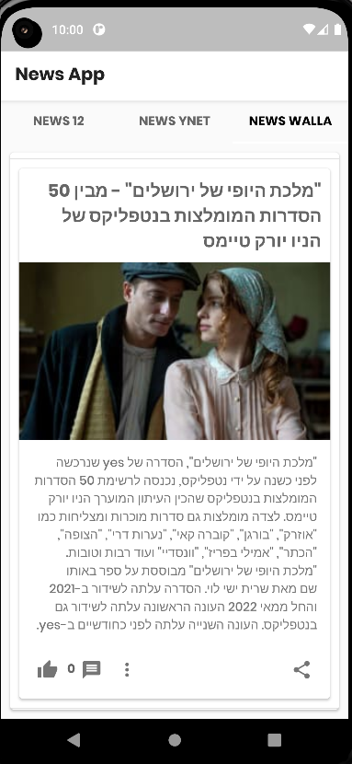
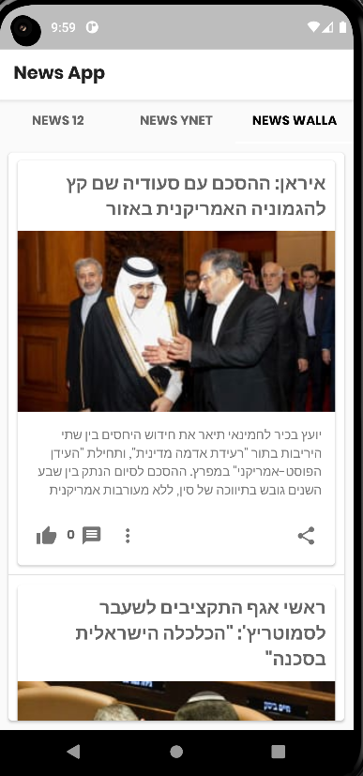
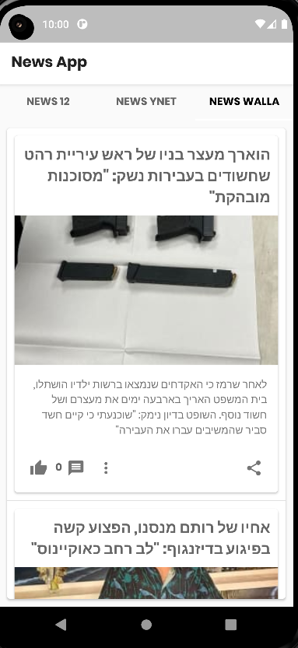
The full article page for each site
After clicking on the desired tab, on the screen appears full list of articles containing for each article a picture, short description, a date of publication and a link to the full article.
By scrolling, the user can move up and down on top of all the articles in the list.
The action of taking the information from the website was done with changing the type of the URL's to Json(the RSS URL’S) , and make a JsonObjectRequest.
The display of the articles on the screen was done using ArrayAdapter which gets a list of items-type objects, where each item represents information for a single story and displays it on the screen as a list.

Slide 9
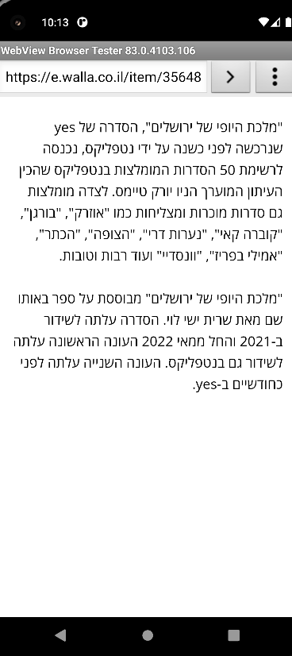
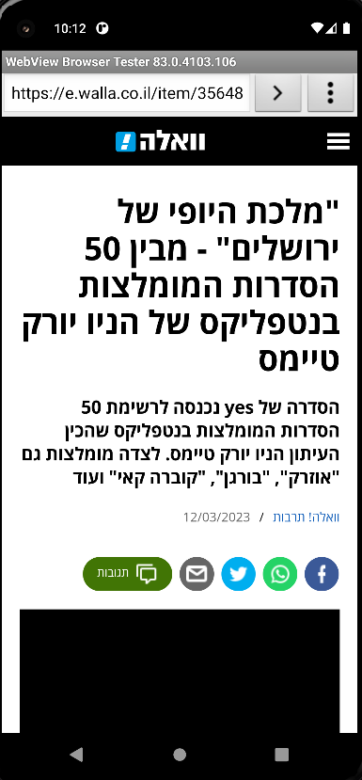
Go to the original site to read the full article
If the user wants to read the full article and not just the description of it, by clicking on the article itself, the user is taken to the original website with the full article to read.
This action done by using listener that listen to the click in a view. Whan the user click the view, the code creates an Intent object. This intent is used to trigger an activity that can handle a ACTION_VIEW, which used to opening a web browser.

Slide 10
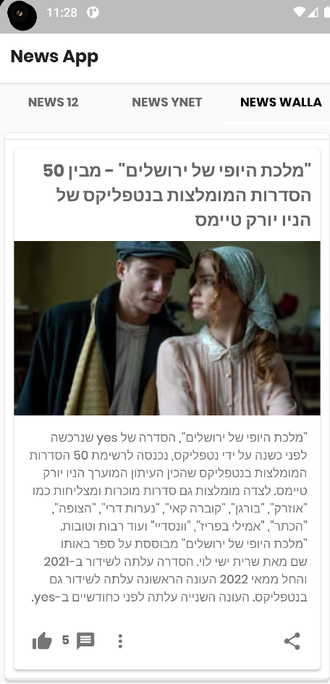
“Like” article
When scrolling on the page of articles, the user can mark like on particular article, and in addition to seeing the number of likes marks on the same article.
This action done by using listener. When the user click on imageViewLike, the code retrieves the current number of likes for an article by parsing the text of textView that count the number of likes.
It then increments the number of likes by 1 and updates the text of the count to show the new number of likes.

Slide 11
Proposals to expansion and future development
The current app supports three news sites. In future development you can try to integrate the application for taking information from multiple news sites.
In addition, it is possible to classify all articles and divide the articles by subject. Each article on a particular topic will be in a list of articles by topic, and not by site.
Another future development could be to take all the information into the app itself and not link to the original website.

